Slide 1
No Wrong People

Slide 2
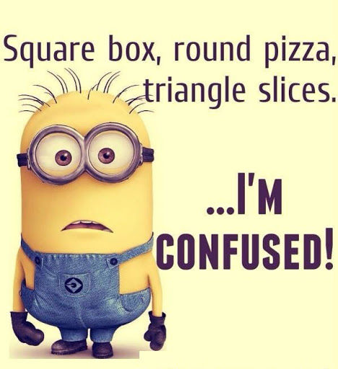

Slide 3
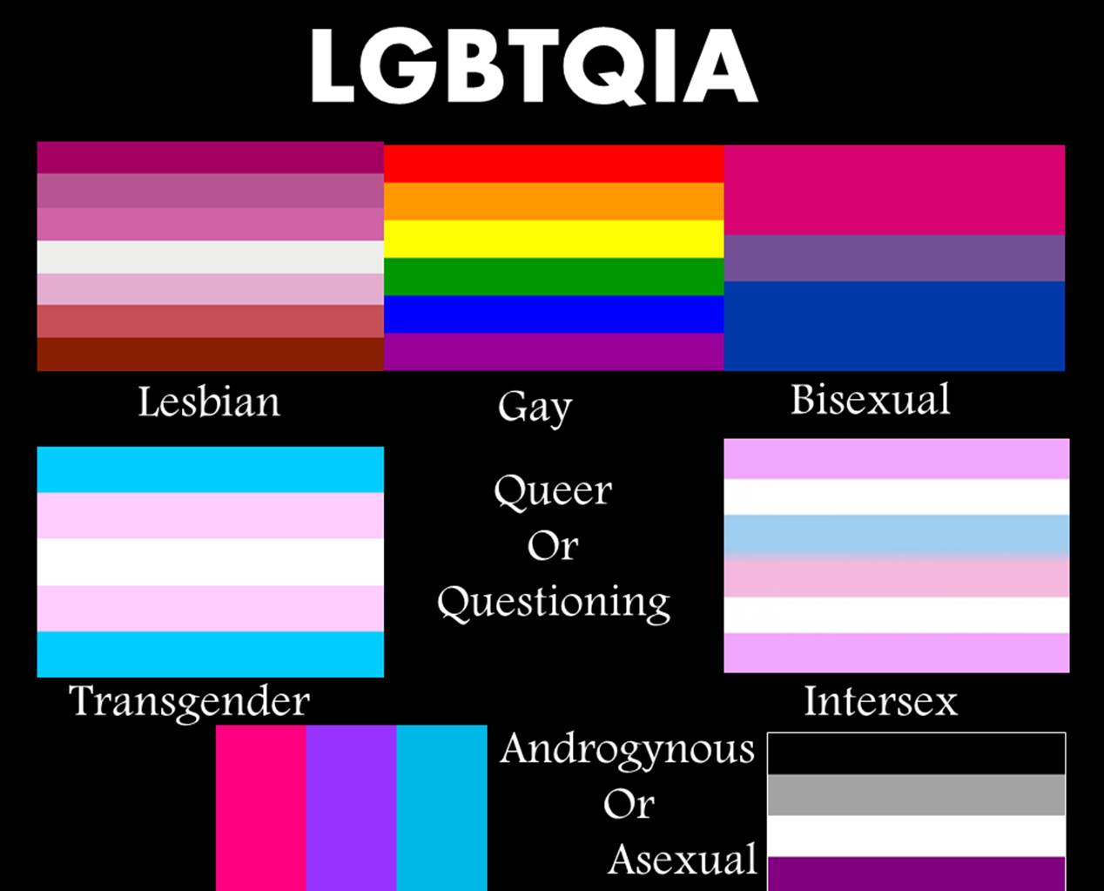

Slide 4
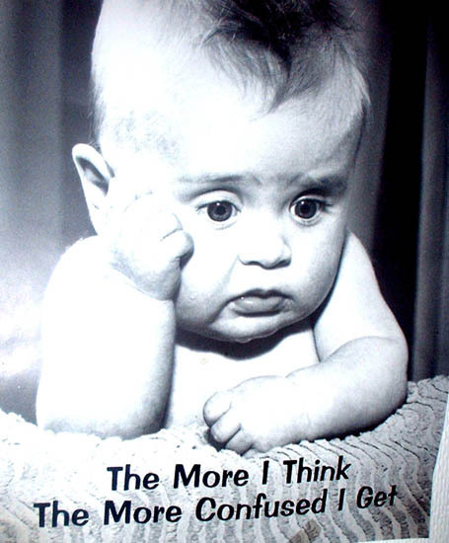

Slide 5
The whole church is confused too

Slide 7
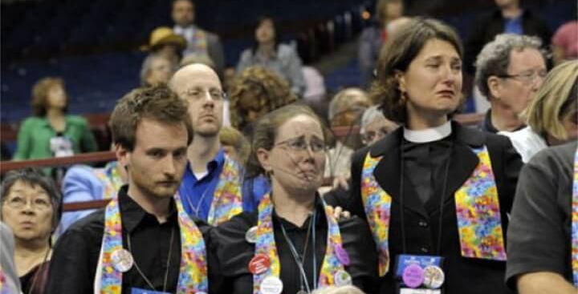

Slide 8
Mutual anger and blame
The Bishops were wrong!
Illegal people voted!
Delegates were bribed!
Partisans used unfair tactics!
From both sides: A tiny minority is hijacking the United Methodist Church!

Slide 9
The result: The church of anti-gay
Ordination—the only stated barrier
Marriage—the only people a pastor can’t marry
Punishment—the only prescribed punishments
Disaffiliation—the only reason a church can leave the UMC with its property

Slide 10
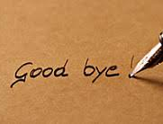
Just leave!

Slide 11
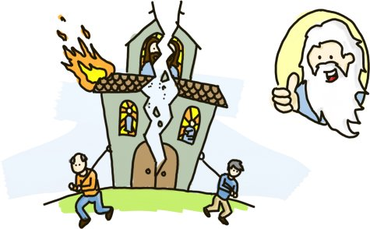
Is this what God wants?

Slide 12
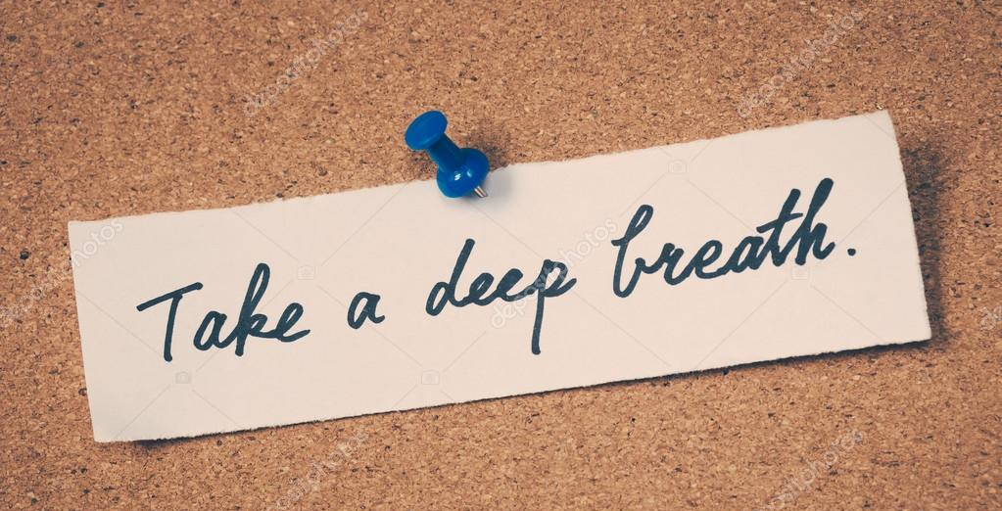

Slide 13
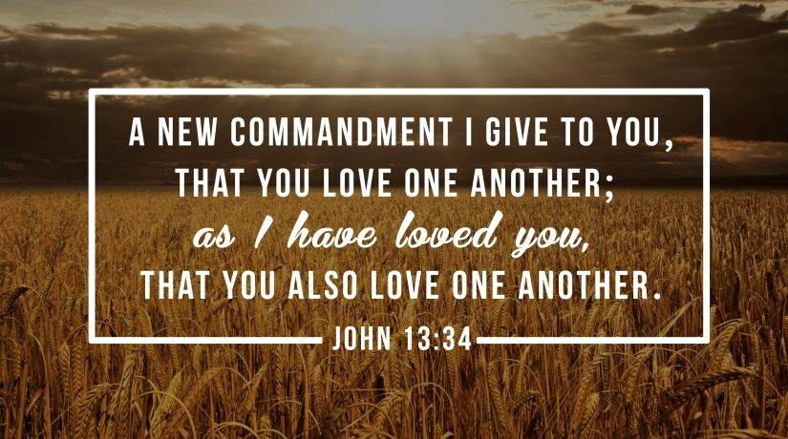

Slide 14
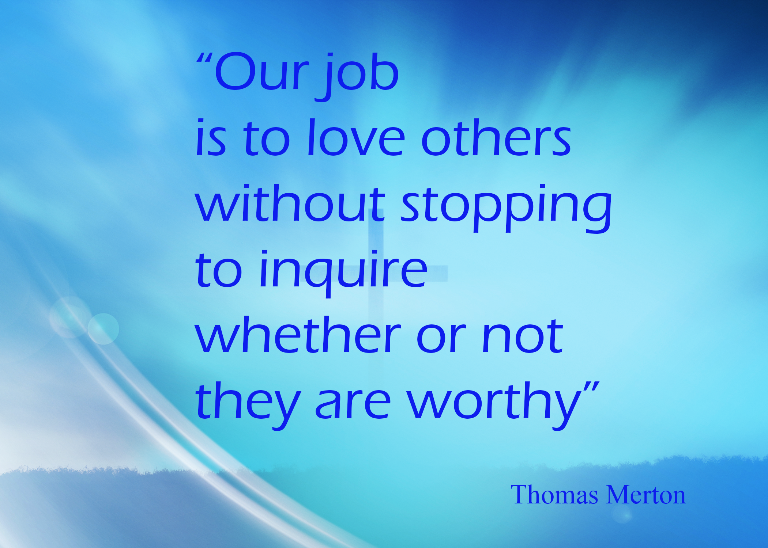

Slide 15
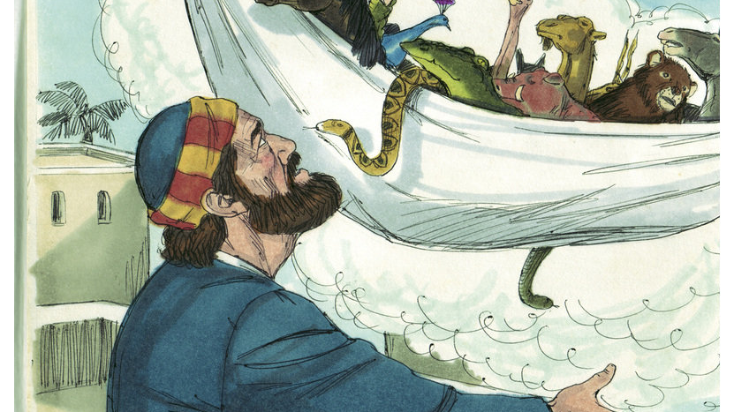

Slide 16
What does it mean?
Probably not really about food. Or at least not mostly about food.
Peter says: “But God has shown me that I should not call anyone impure or unclean.” Acts 10:28

Slide 17
What does the church do?
Challenges Peter’s actions, but
Listens to Peter’s explanations, and
Calms down, and
Praises God, and
Agrees that the Gospel is for the Gentiles too, but…

Slide 18
…proceeds to preach only to the Jews.
Paul is the first to actively seek out the Gentiles
In Acts 15, we read of an attempt to make the Gentile Christians second-class citizens
But full inclusion wins

Slide 19
Who belongs in OUR church?

Slide 20
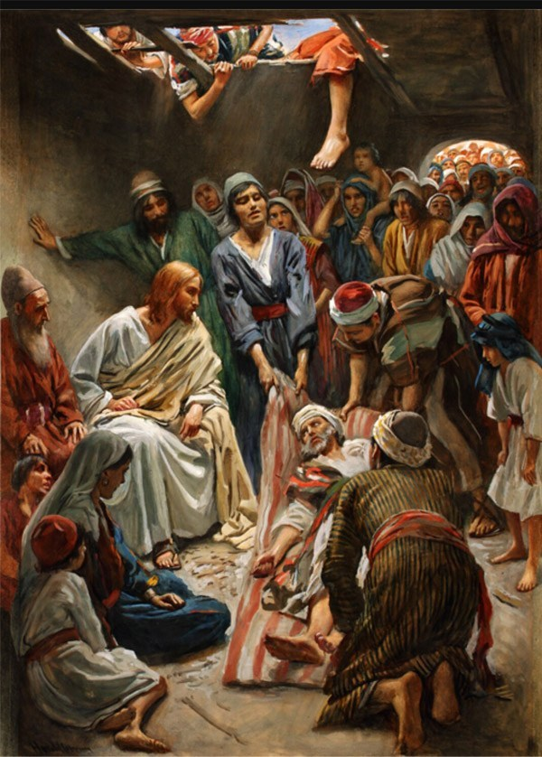
Outcasts and Jesus

Slide 21
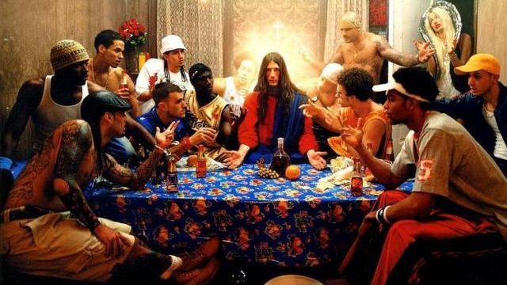

Slide 22
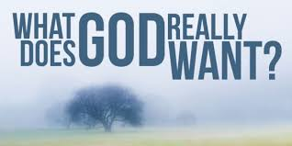

Slide 23
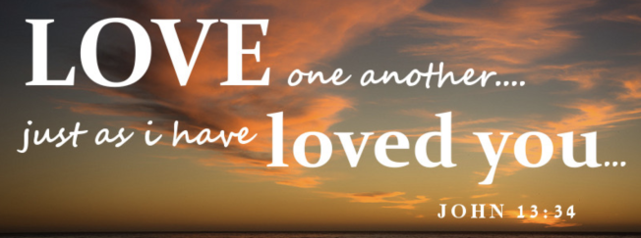

Slide 25
Rules and Regulations
Accurate Theology
Righteousness
Authority and Power
Strong Rhetoric
Holy Purity
Organizations and Ministries
Love

Slide 26
Who belongs in OUR church?
Everyone belongs
all the way in
All means all!

